Slide 1
The use of Deep Reinforcement Learning in Tactical Asset Allocation
Musonda KATONGO
February 04, 2021

Slide 2
Group 01
Musonda KATONGO

Slide 3

Government Issued Photo ID

Slide 4
Project Goal and Importance
Tactical Asset Allocation (TAA) is an active portfolio management strategy
It aims at allocating the asset weights in a portfolio in order to take advantage of market trends
The project aims at building a TTA model that is able to accurately capture short to medium term market trends
Model should be able to maximize risk adjusted returns of
the portfolio

Slide 5
Literature Review/Background
The following are some of the related works which were reviewed for the study:
Yang, H., Liu, X., Zhong, S. and Walid, A., 2020. Deep Reinforcement Learning for Automated Stock Trading: An Ensemble Strategy. SSRN Electronic Journal.
Chakravorty, G., Awasthi, A., Da Silva, B. and Singhal, M., 2018. Deep learning based global tactical asset allocation. SSRN Electronic Journal
Neuneier, R., 1996. Optimal asset allocation using adaptive dynamic programming. In Advances in Neural Information Processing Systems (pp. 952-958).
Obeidat, S., Shapiro, D., Lemay, M., MacPherson, M.K. and Bolic, M., 2018. Adaptive portfolio asset allocation optimization with deep learning. International Journal on Advances in Intelligent Systems, 11(1), pp.25-34.
Notes:
(Yang, Liu, Zhong and Walid, 2020)[18] have proposed a Deep Reinforcement Learning (DRL) Library that uses various DRL algorithms for portfolio construction and stock trading
The methodology used adopts this approach in the implementation of DRL models based on the Stable baselines Models
Chakravorty et al., 2018 in their paper, Deep Learning based Global Tactical Asset Allocation, show the use of deep neural networks with macro-economic data in conjunction with price-volume data in a walk-forward setting to do tactical asset allocation
Neuneier, formalizes this representation of the TAA problem as a MDP and proposes the use of Dynamic Programming or Reinforcement Learning algorithms in solving such an optimization problem
Obeidat et. al., 2018 used a methodology for TAA based on prediction of future returns using the Long Short Term Memory (LSTM) Neural Network (NN)

Slide 6
Literature Review/Background Cont. . .
The project contributes to the current research in the subject in the following ways:
Employees the use of Neural Network Autoencoders in the selection of stocks to be included in the portfolio for the period;
The research proposes the use of a number of features (technical indicators) in the implementation of a DRL model
Notes:
Instead of considering the entire stock constituent for a portfolio, the methodology proposes a way of filtering stocks so that less volatile stocks are used for contracting the portfolio.
Neural Network Autoencoders are also used for feature dimensionality reduction

Slide 7
Assumptions and Choice of Technology
The following are the assumptions made in the implementation of the model:
The market is liquid and it is possible to trade at any time;
Transactions are small enough not to affect the market price of the assets
Transaction costs have been assumed at 0.1% of each trade total value.
The models are developed and coded using python programming language
GitHub Link: https://github.com/Musonda2day/Asset-Portfolio-Management-usingDeep-Reinforcement-Learning-
Notes:
The market is liquid meaning that all sell and buy transactions will go through
Transactions are small enough not to affect the market price of the assets which means the number of assets traded is small enough compared to the overall market liquidity.
Python is used as it is open source and have a number of ML packages and Libraries
The DRL models are implemented using the Stable Baselines Libraries
The Mean-variance Optimization is implemented using the PyPortfolioOpt library
Backtesting and benchmarking is achieved using the Pyfolio library
Neural Networks for Asset Selection and Feature Reduction is implemented using TensorFlow 2.0

Slide 8
Peer Review Feedback
From the peer review feedback, the researcher considered the following in the development of the project:
Clearly defining the benchmark portfolio strategies based on equal weights and mean-variance optimization;
The researcher used cumulative portfolio value as the object function. The use of risk adjusted returns (Differential Sharpe) has been proposed for future work;
Use of a wider space of asset class has also been proposed for future work in maximizing portfolio risk adjusted returns.
Notes:
The main critical feedback received included:
The construction of the naïve case for comparison was not clearly defined in the project review
Often not possible to reduce portfolio risk beyond a certain point by only using equities

Slide 9
Methodology
Select the constituent stocks or assets that will form the portfolio
Feature selection and data pre-processing
Perform Feature Reduction using Neural Network Autoencoders
Split the data into train data and test data
Construct benchmark portfolios
Construct the DRL models based on the DDPG, PPO and A2C algorithms
Backtesting the performance of the portfolios
Notes:
We have considered the 30 stocks of Dow Jones Industrial Average (DJIA) to form part of our portfolio.
Perform stock selection from the total stock constituent
Technical indicators are added to the selected stocks to aid in the performance of the agent
Benchmark portfolios based on equal weights allocation and mean-variance (maximum Sharpe) allocation which are used to benchmark the DRL model;
Test the performance of the DRL models against the mean variance and the equal weights portfolios.
The DRL model based on the A2C algorithm is further benchmarked with the DJIA Index

Slide 10
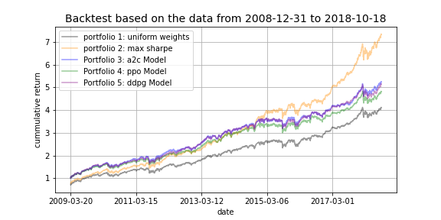
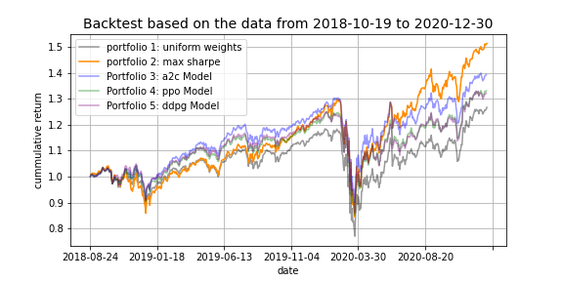
Summary of Results
Backtest on train and test data
Notes:
We can see that the mean-variance (portfolio) outperforms all the other portfolios on the training data.
The three DRL models however, performs better than the equal weight allocation portfolio
The A2C model performs slightly better than the other DRL models
With the test data we see that the mean-variance portfolio outperforms all the other portfolios during the period starting 2020
The DRL models however, performs better before this period with the A2C model with the overall best performance amongst the three
Overall we can note that there is significantly improved performance of the DRL models on the test data resulting in outperforming the mean-variance during the period before the 2020 year.
The underperformance of the DRL models during the period starting 2020 could be attributed to the market fall during the period of the COVID-19 pandemic.

Slide 11
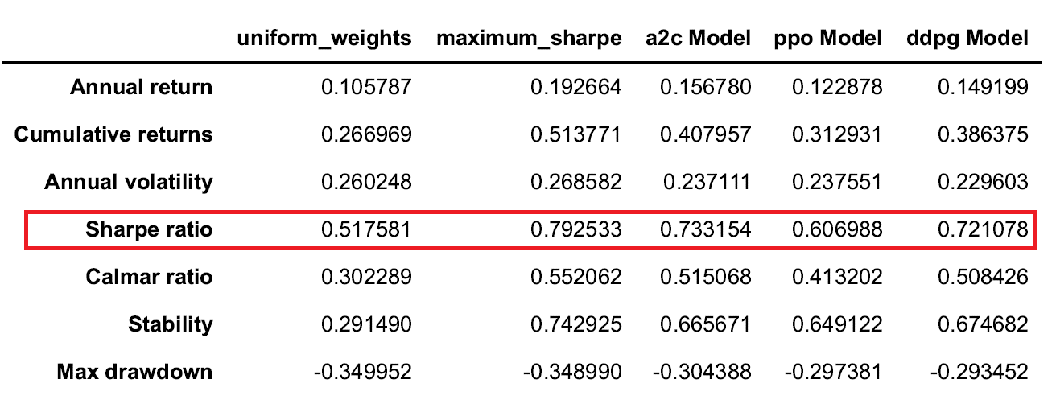
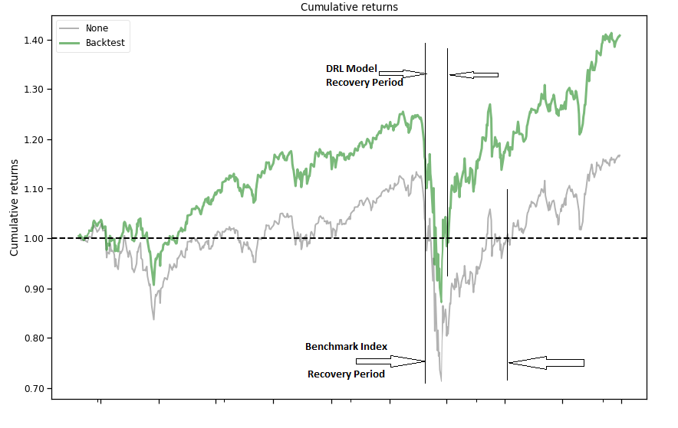
Summary of Results Cont. . .
Mean-variance presents the highest Sharpe ratio followed by the A2C
The equal weight allocation has the lowest Sharpe Ratio
The DRL model outperforms the benchmark index in all market regimes

Slide 12
Summary of Results Cont. . .
The project work contributes to the current research by combining the asset selection methods with DRL methods for asset allocation
The model could not produce consistently better performance than the mean-variance optimization
The model however, shows better performance than the benchmark index in all market regimes
DRL models have a potential to perform better than the traditional allocations methods
Rebalancing periods needs to be optimized to adjust for transaction costs

Slide 13
Conclusions
The project aimed at developing a TAA model based on DRL
DRL is used to perform asset allocation based on the reward function of cumulative portfolio value
The developed model outperforms the mean-variance optimization in periods of less market uncertainties
The model outperforms the benchmark index in all market regimes
The performance of the model can be fine-tuned to ensure consistent performance in all market regimes

Slide 14
Future Scope of Work
Explore the use of differential Sharpe ratio as the reward function for the DRL model
Application of the DRL model on a bigger stock constituent and consider a wider space of assets
Consideration of a number of technical indicators
Consider using different portfolio initialization strategies apart from the equal weights initialization
Optimize the rebalancing period

Slide 15
Thank you
Notes:
A huge thank you to WQU for affording an opportunity to complete this MScFE
Thanks to all the faculty members for their valuable guidance and instructions as well as the student support
A great thank you to the peers for their collaborative interactions and support
A huge thank you to my family for the support during the period of my studies.

